Slide 1
Introduction to R and RStudio
Yujia Luo
22-11-2021

Slide 2
Course outline
Session 1: basic syntax
Session 2: data manipulation and graphic generation
Session 3: basic statistics
Session 4: sequence data presentation

Slide 3

What is R
A free, open-source software and programming language
Data analysis
Scientific disciplines
Popular for its graphical capabilities, statistical analysis

Slide 4
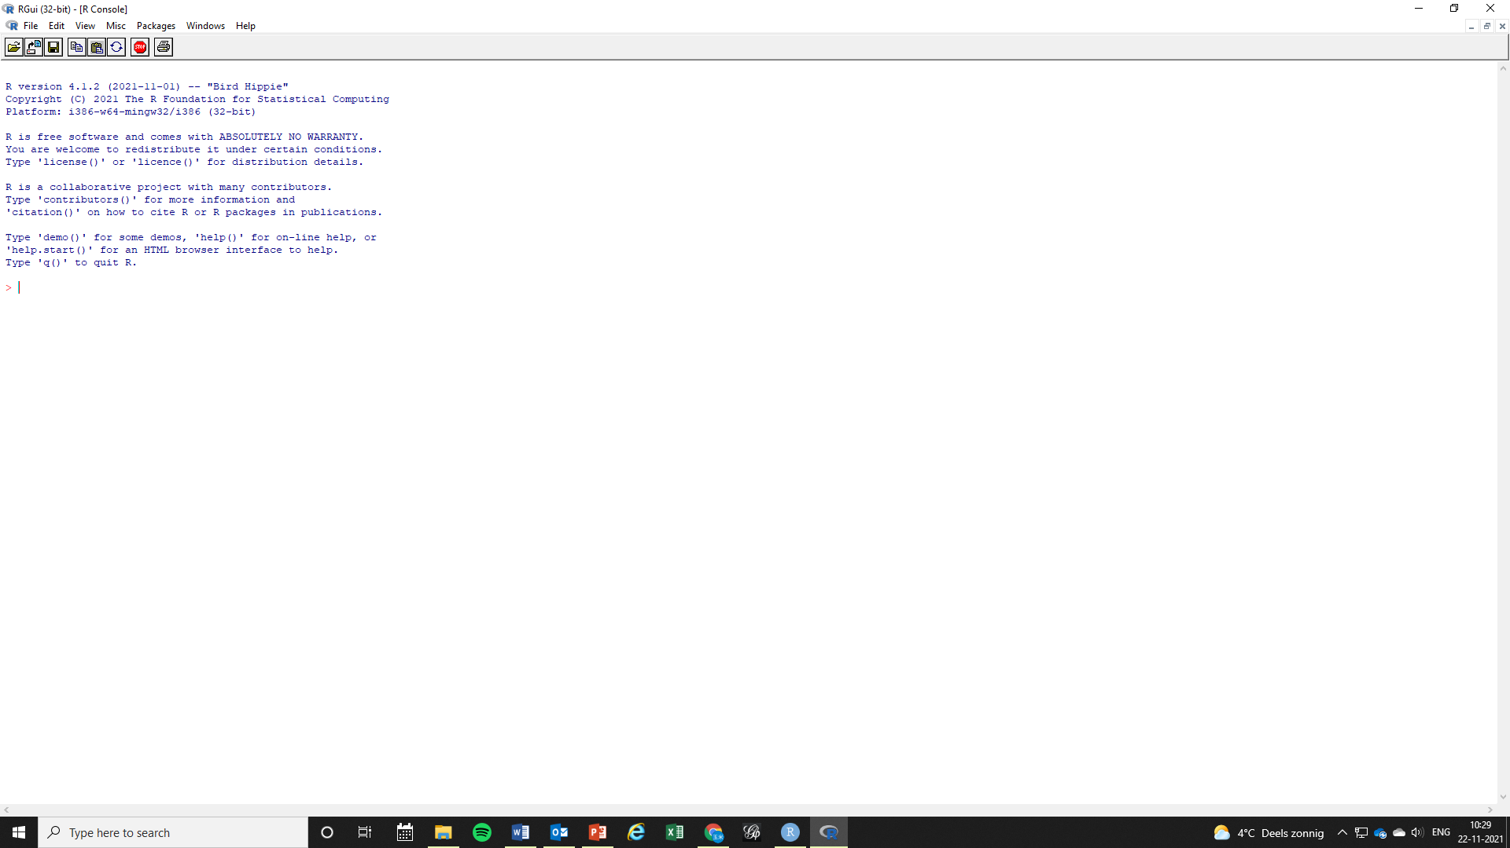

Slide 5

What is Rstudio
An integrated development environment (IDE) that allows you to interact with R more readily
R runs the actual instructions
We will use RStudio in this tutorial

Slide 6
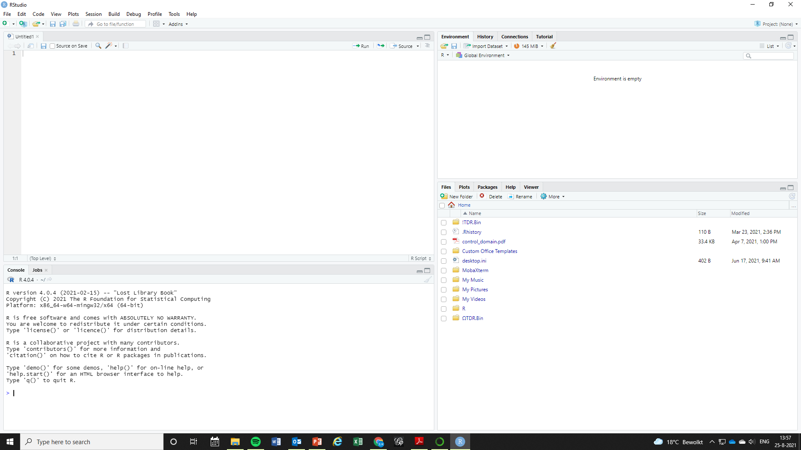
Source: write your script
Environment & history: data
Console: run the script
Files; packages; graphs

Slide 7
R or Python?
Depends
What does your research group/supervisors/people around you use?
If you have problems, can you get help from them?

Slide 8
The working directory (wd)
The working directory is R’s default place to look for files
The wd contains raw data (i.e., excel, txt, csv files)
Set your wd:
setwd("C:/Users/yluo/Dropbox/Introduction")
Find your wd:
getwd()

Slide 9
R basics: object
In R everything is an object
Object types:
Vector
Factor
Matrix
List
Data.frame
Function

Slide 10
Vector
A vector is an ordered collection of data of the same type
function c() :

Slide 11
Factor
A factor is an efficient way to store character data where elements are repeated

Slide 12
Matrix
A matrix:
• Has 2 dimensions: rows and columns
• Can only contain data of one type, numeric or character

Slide 13
List
• A list is an ordered collection of objects
• The components of a list can be of any class

Slide 14
Data.frame
• A data.frame is a matrix where the columns can be of different classes numeric, character, factor, . . .
• The [ and ] operators are used as in a matrix
• Columns in a data.frame can be accessed with the $

Slide 15
Function
• Functions are the tools in R
• Every action is performed by calling a function, we have used several already
• A function is also an object
• Functions can have arguments within the parentheses
– functionName(argument1, argument2, argument3, ...)

